Slide 1




MPEG-DASH live-stream in an unstable environment
Team Members:
Avraham Ayaso, Lavy Raz
Instructors:
Itzik Ashkenazi, Aviel Glam (Rafael)

Slide 2


Background

Slide 3
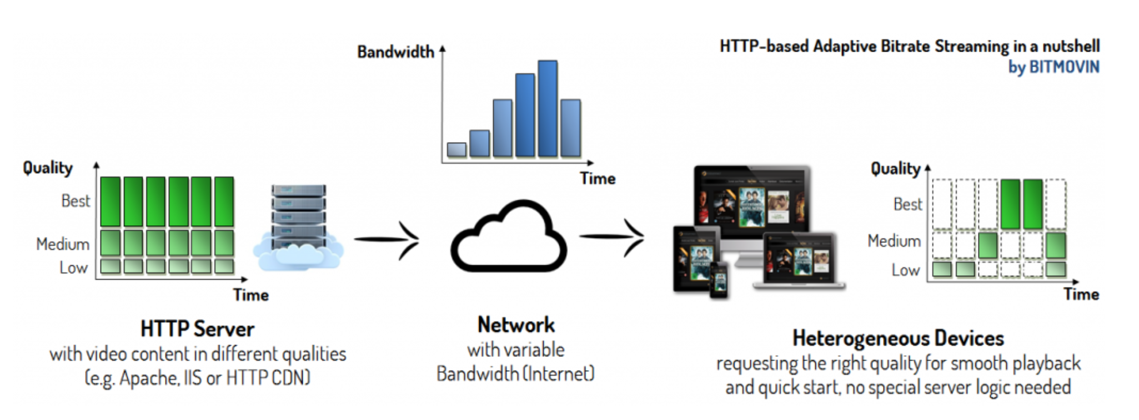
MPEG-DASH

Slide 4
Why over http?
Commonly used protocol
Uses standard port (port 80 or 443)
Ensures the stream is rarely blocked by Firewall

Slide 5
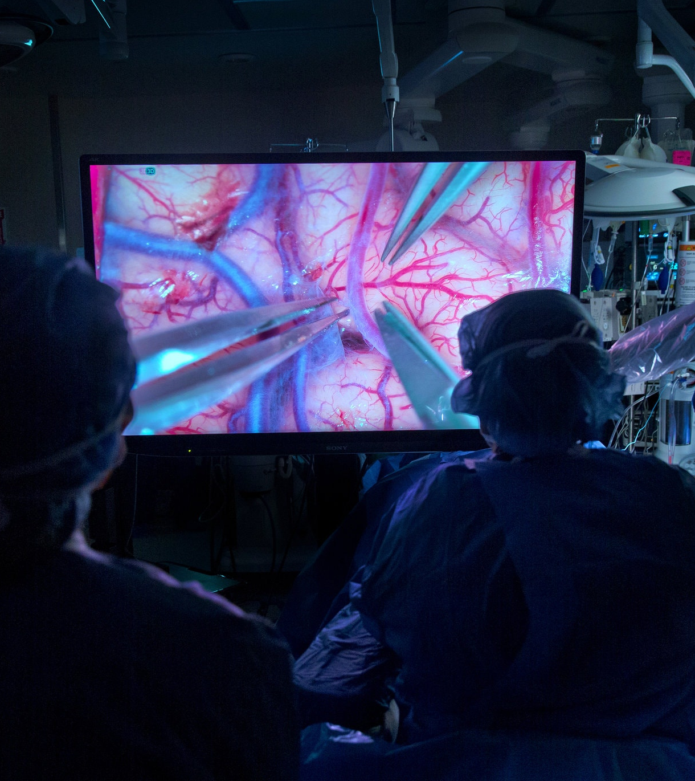
Mpeg-Dash livestreaming
The protocol main goal was to stream media files and wasn’t meant for live-streaming
Our research extends the protocol to achieve that with tolerable delay

Slide 6
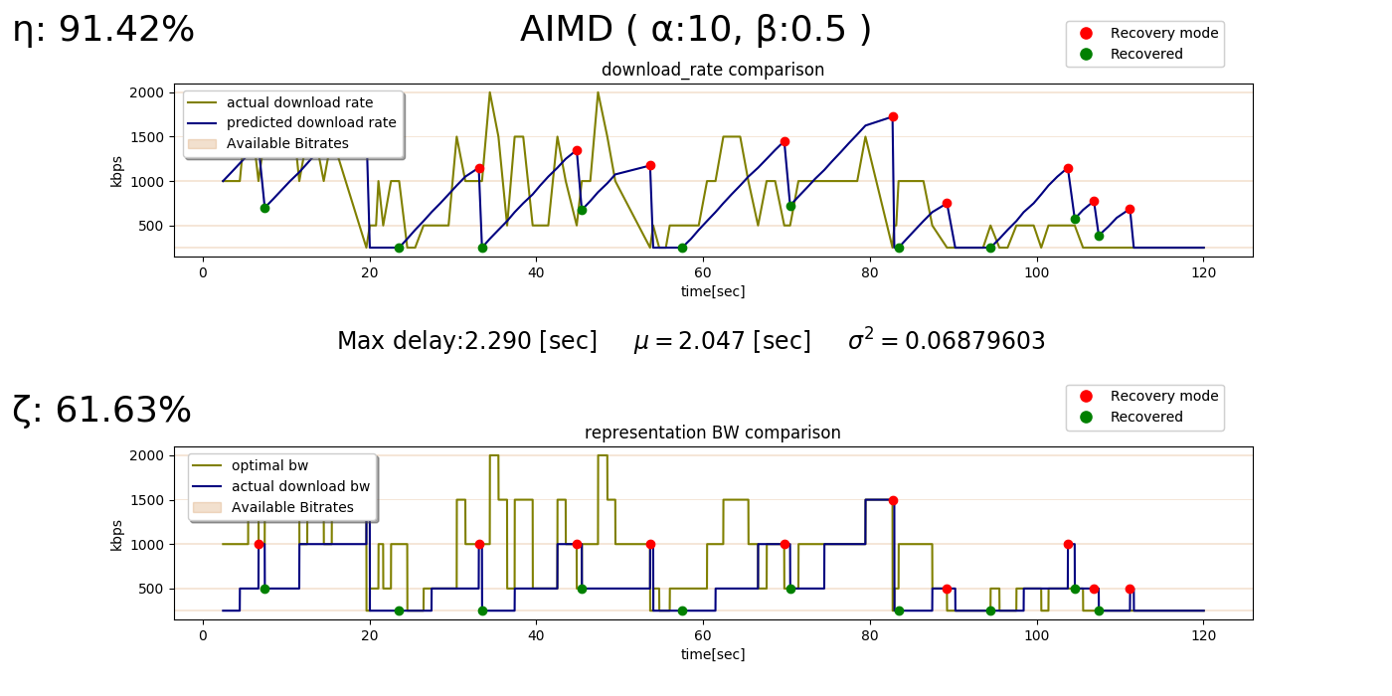
Goals
1. Implement algorithms that manage the buffer and adjust it to the changing bandwidth, while maintaining live streaming.

Slide 7
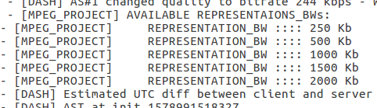
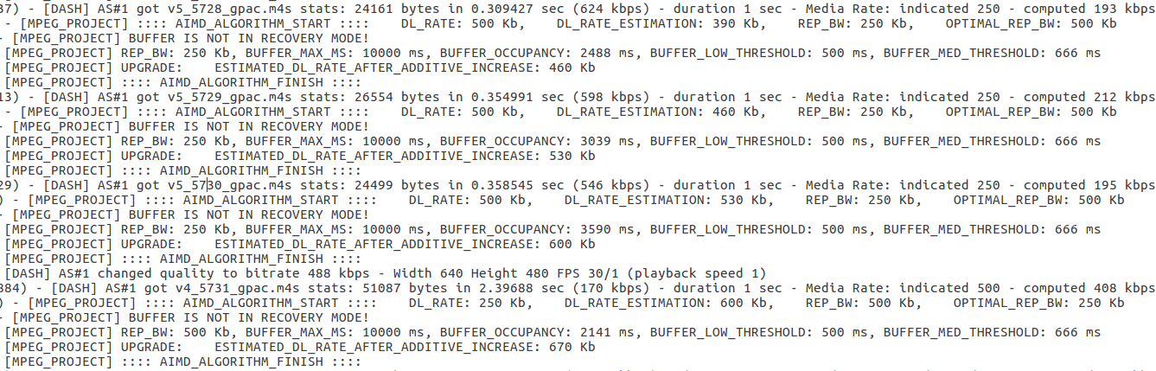
Goals
2. Comprehensive analysis on each streaming session:
algorithm’s specifications
streaming statistics
bandwidth utilization

Slide 8
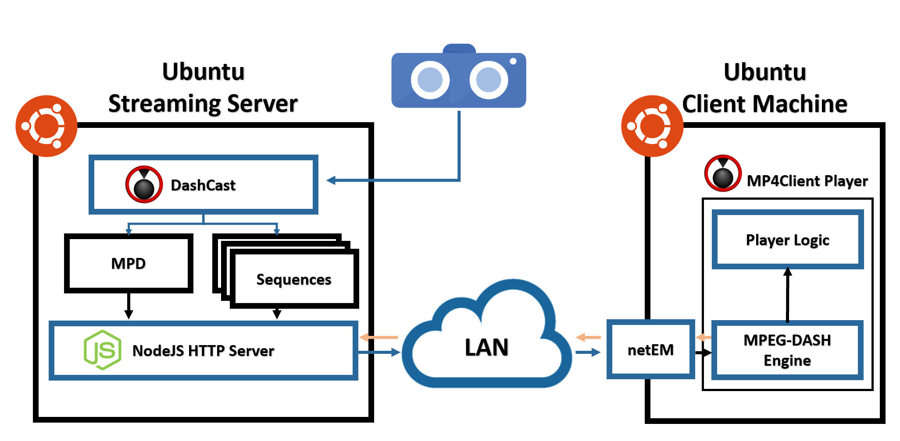
MPEG-DASH architecture
WebCam – Installed on top of the server pc. Generates the live video stream.
DashCast – Breaks the input stream into a sequences of small segments and stores them on the server.
Each segment is stored in several different bitrates.
It creates an MPD file which defines the available qualities, and more features of the segments stored on the server.
Player Logic –
Plays the live video stream. ☺
NodeJS – Exposes the MPD file and the sequences through Web interface. The client receives the segments data using HTTP GET commands.
netEM – Simulates an unstable network behavior on the client’s computer.
Capable of adjusting the BW, packet loss and bit error rate.
MPEG-DASH engine – Generates HTTP GET commands to the server asking for the best quality the client can stream while trying to maintain live stream.
WEB

Slide 9
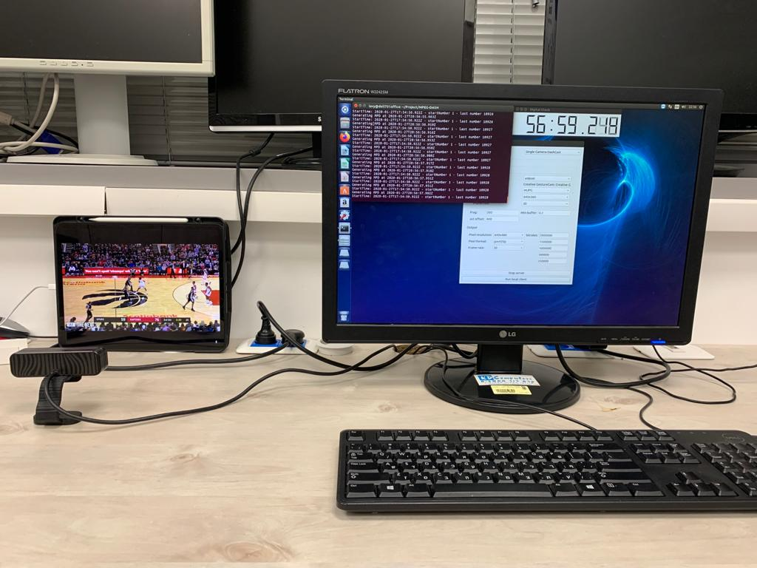
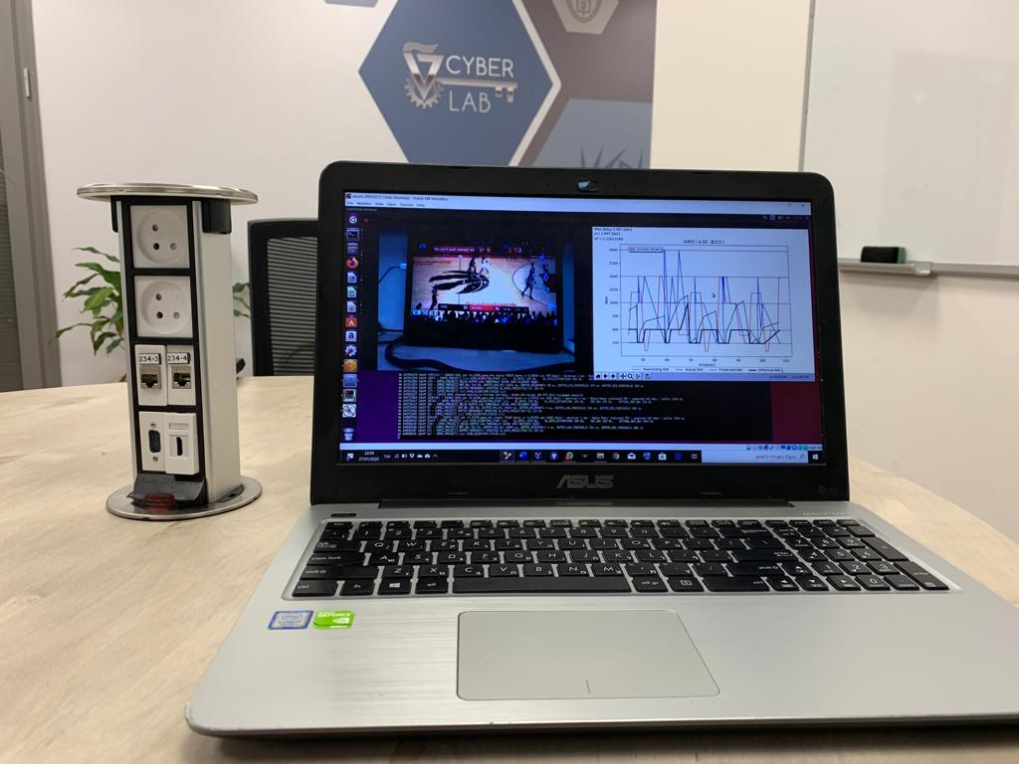
Our setup

Slide 10

Our Research

Slide 11
Work assumptions
There is only a single client
The results are based on simulations using NetEm to control BW
The camera is connected directly to the server

Slide 12

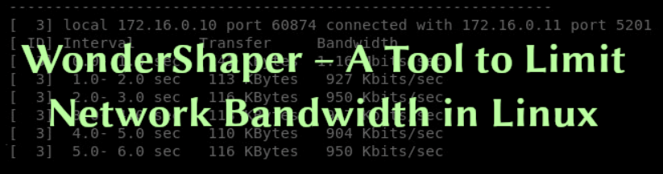


Open sources

Slide 13
WORK METHODOLOGY
Learn the protocol and the given tools
1
Discuss possible solutions to our problem
2
Implement our algorithms
3
Test and analyze our algorithms in different environments
4

Slide 14
KPI - KEY PERFORMANCE INDICATOR
MOTIVE:
η - measures the theoretical utilization of our algorithms.
The algorithm prediction vs. the actual download rate

Slide 15
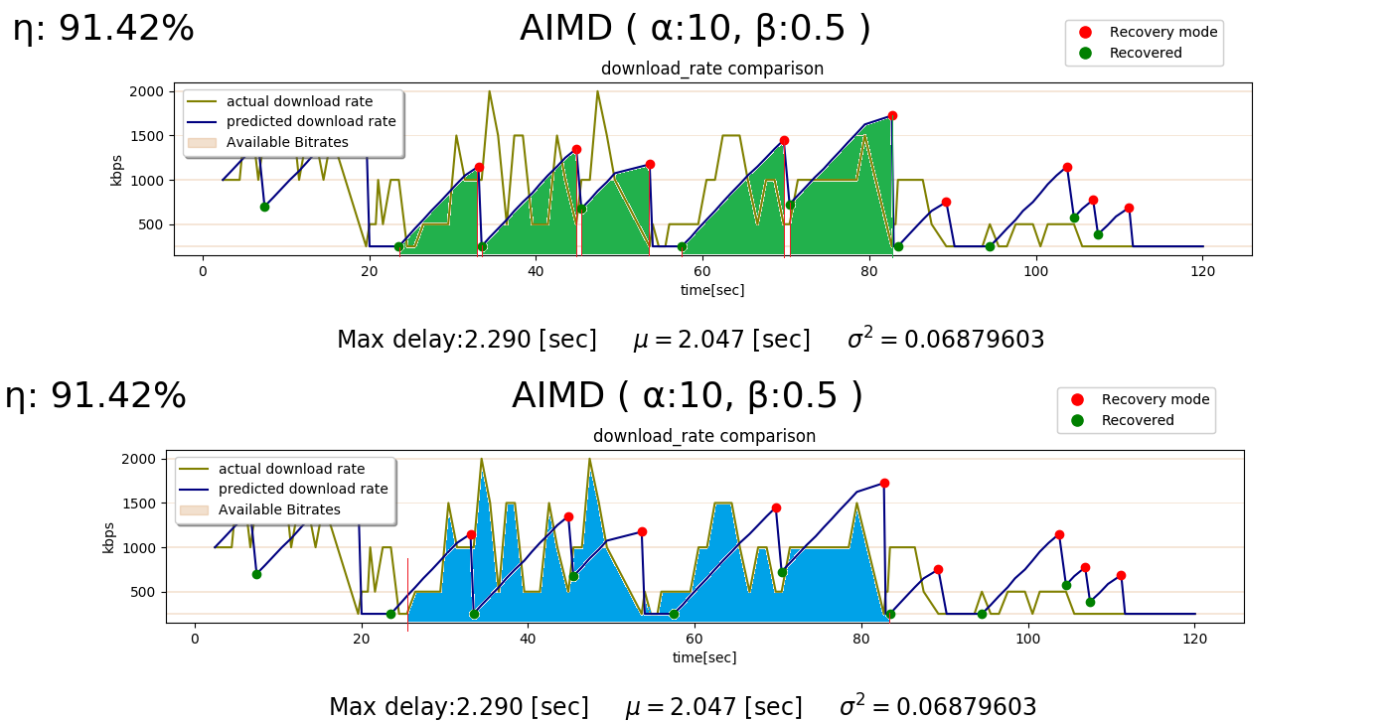
KPI – KEY PERFORMANCE INDICATOR
η = PREDICTED_DL_RATE/ACTUAL_DL_RATE

Slide 16
KPI - KEY PERFORMANCE INDICATOR
MOTIVE:
ζ - measures the practical utilization of our algorithms:
The requested BW vs. the optimal BW

Slide 17
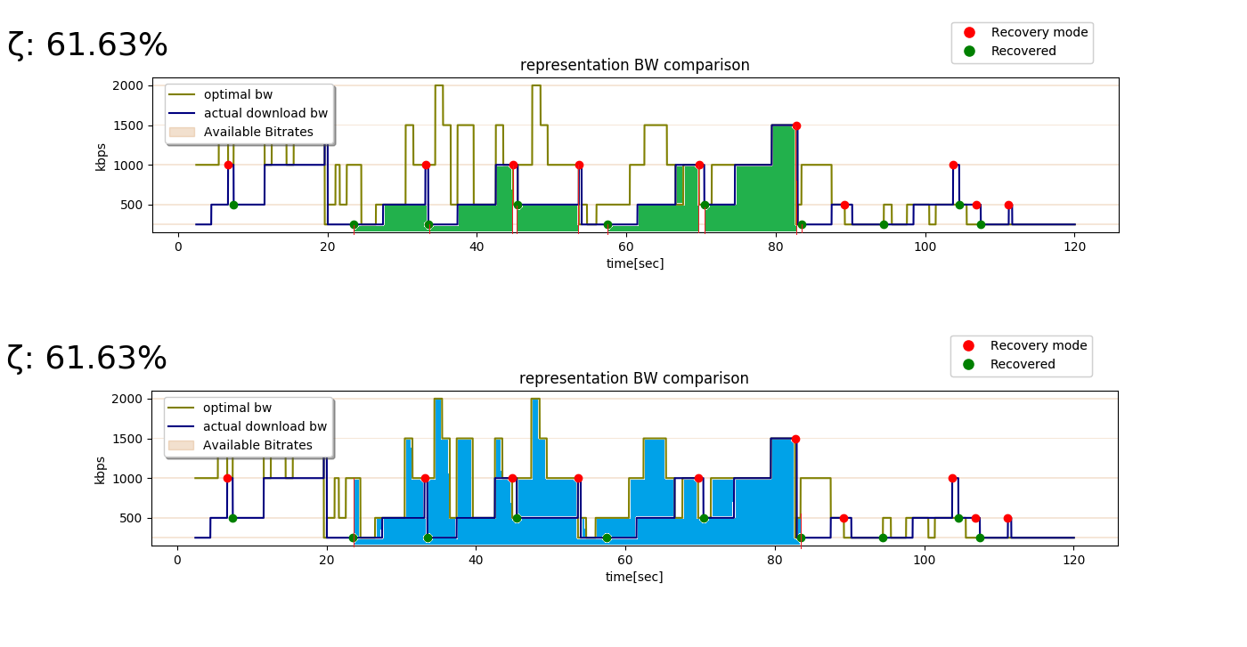
KPI – KEY PERFORMANCE INDICATOR
ζ = REQUESTED_BW / OPTIMAL_BW

Slide 18

Implemented algorithms

Slide 19
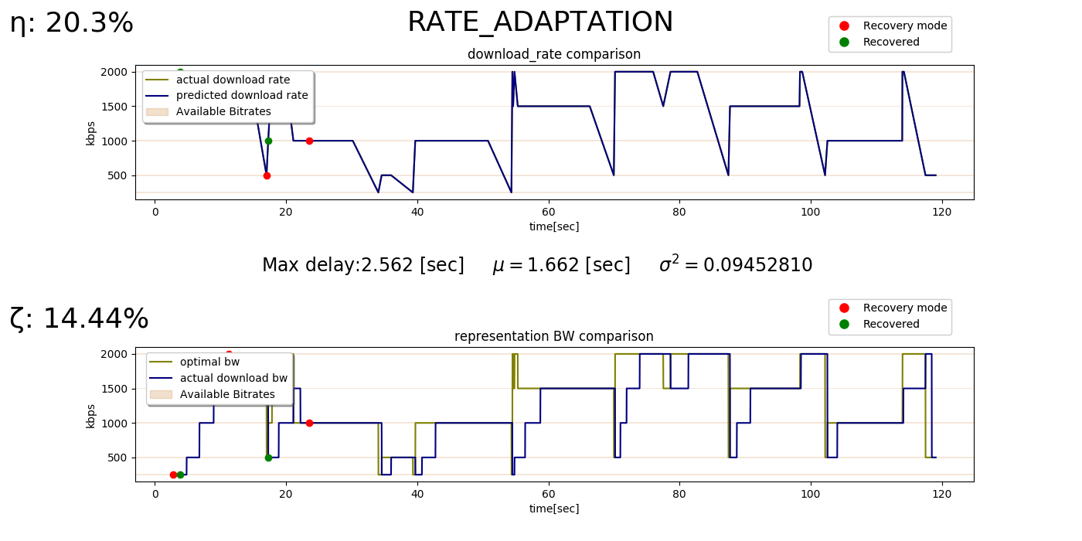
rate AdaptATION
Predicts based on last download rate
More prone to fail in live streaming.

Slide 20
Buffer Regulation
Our priority is to maintain tolerable delay in live stream over quality.
We achieve that by regulating the client’s buffer, which holds the segments that are yet to be played.

Slide 21
AIMD (Additive Increase Multiplicative Decrease)
Based on TCP protocol
Conservative algorithm

Slide 22
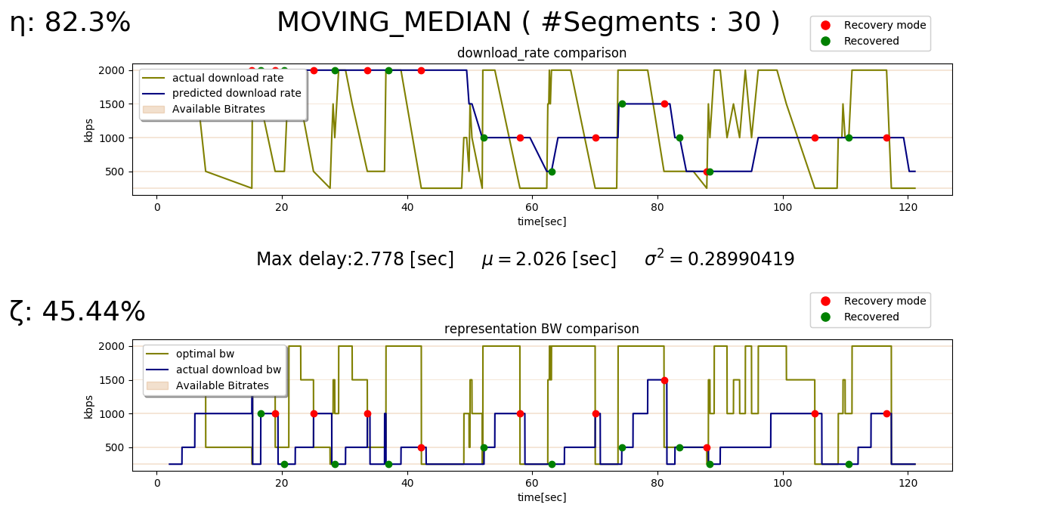
MOVING MEDIAN
Based on statistics
Non-conservative algorithm

Slide 23

Presentation

Slide 24
results
η - theoretical utilization (%)
PREF.ALG | MOVING-MEDIAN |  |  | AIMD
 | #segments=30 | #segments=20 | #segments=10 | =15α | =10α | =5α | Parameter Environment
MEDIAN (30) | 88.51 | 75.69 | 85.19 | 72.75 | 74.37 | 72.27 | Static
AIMD (15) | 75.46 | 83.82 | 80.06 | 94.81 | 91.42 | 74.93 | Quasi-static
MEDIAN (10) | 72.11 | 88.39 | 95.73 | 64.39 | 70.34 | 55.09 | Dynamic
MEDIAN (10) | 86.82 | 74.42 | 86.96 | 83.37 | 79.8 | 56.22 | Bursty
MEDIAN (30) | 82.3 | 71.48 | 62.49 | 65.05 | 71.48 | 42.82 | Noisy

Slide 25
results
ζ - practical utilization (%)
PREF.ALG | MOVING-MEDIAN |  |  | AIMD
 | #segments=30 | #segments=20 | #segments=10 | =15α | =10α | =5α | Parameter Environment
MEDIAN (30) | 77.11 | 67.6 | 70.8 | 49.3 | 52.31 | 54.19 | Static
MEDIAN (10) | 65.21 | 64.74 | 67.52 | 62.08 | 61.63 | 50.61 | Quasi-static
MEDIAN (10) | 60.88 | 66.94 | 68.54 | 44.5 | 49.94 | 40.1 | Dynamic
AIMD (15) | 55.71 | 44.41 | 57.52 | 57.87 | 53.96 | 40.6 | Bursty
MEDIAN (30) | 45.44 | 42.48 | 33.47 | 39.12 | 42.9 | 25.66 | Noisy

Slide 26
Conclusions
According to our analysis:
The open source’s algorithms we tested didn’t fit for live-stream purposes.
Due to improper regulation on the client’s buffer.
Moving-Median adapts to the client’s network better.
Due to learning the network’s BW via the download rate history.

Slide 27
Products and contributes
Accomplishing the goals of the project
Built a repository and instructions how to use it
Built a friendly infrastructure and GUI
Built and adapted new algorithms

Slide 28
What we learned
MPEG-DASH protocol and different algorithms
Work with open sources and GIT
Explore and Analyze results

Slide 29
Future ideas
Implement a learning method according to the client’s network
Improve the research to be more scalable

Slide 30

Questions?

Slide 31

Thank you

